Slide 1
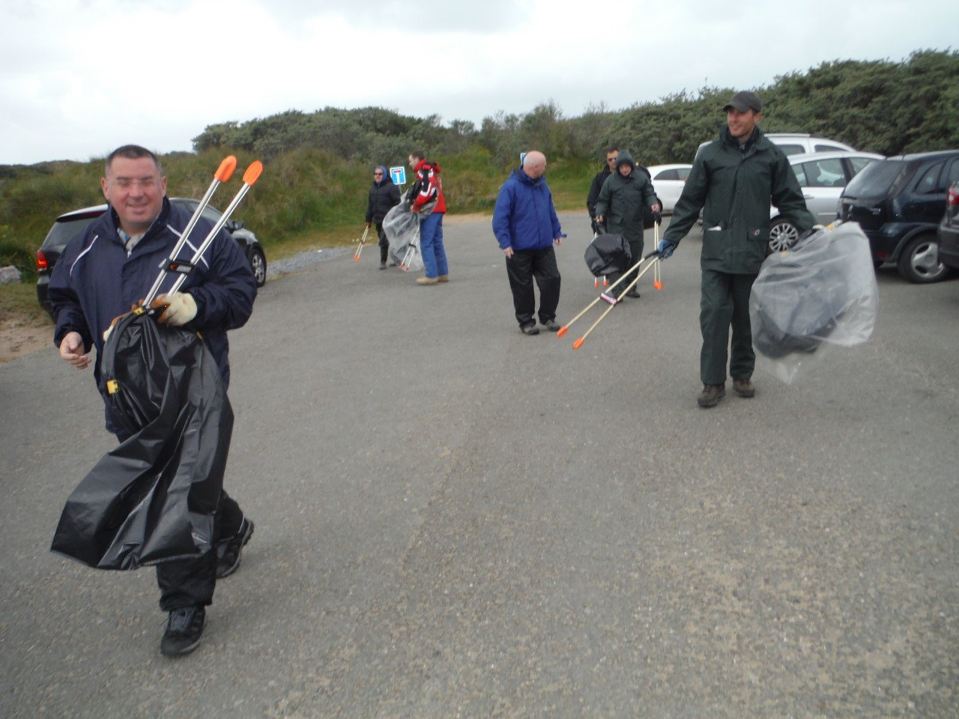
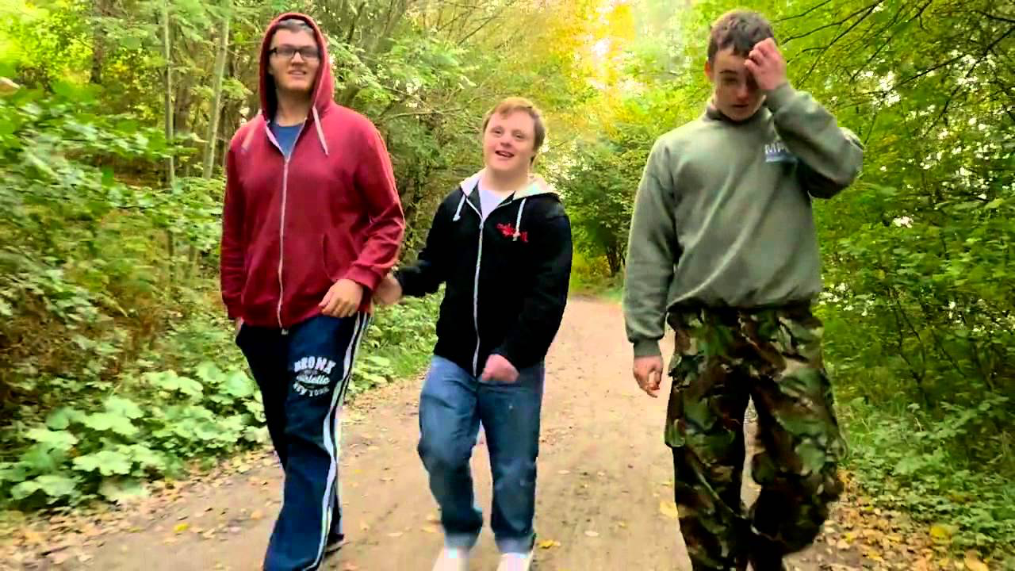
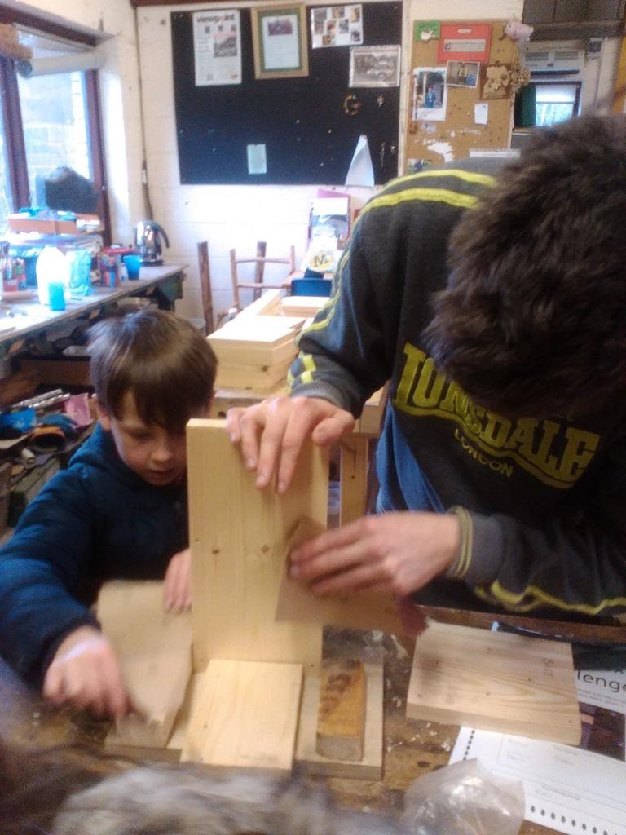
Visible & Valued
Creating an inclusive Wales
Our vision is a world where people with a learning disability are valued equally, listened to and included
Ein gweledigaeth yw byd ble mae pobl ag anabledd dysgu yr un mor werthfawr â phawb arrall, ble mae pobl yn gwrando arnynt ac yn eu cynnwys.
Notes:
This slide is a holding slide. You should start and/or finish your presentation with this slide. You can copy this slide.
Here are some general guidelines to producing clear presentations for Mencap.
The clearer your presentation, the easier it will be for people to understand. This template is set up to be as accessible as possible – for everyone, including people with a learning disability.
Keep it simple – don’t detract from what you want to communicate
Clean and clear = accessible
Use the Mencap templates – always use the master template pages.
Don’t overcrowd each slide. The less points the better.
The Mencap maroon colour is set up in the colour palette please use where appropriate.
Just because you can, doesn’t mean you should! – Use animations, transitions and effects sparingly. Use the least distracting ones and be consistent with the one you choose.
When changing the size of images or logos only use the corner point – this keeps the picture in proportion and stops it from stretching or distorting. Never use the middle points on the box this will distort the image.
If you want to crop an image rather than just making it smaller you can use the cropping tool which is found under ‘view>toolbars>picture’ Click on the image you would like to crop and then click on the cropping tool (looks like 2 arrows overlapping). Then move the black marks up or down to crop the image to the shape you want.
Use rules and guides to make sure everything lines up. Clear spaces and borders are important for accessibility and consistency.
The template is set up in the typeface FS Mencap if you use it on a computer that doesn’t have Mencap’s typeface it should automatically default to Arial. This won’t effect the layouts you have made as FS Mencap and Arial are similar sizes.
The help menu can tell you how to complete many tasks within powerpoint.

Slide 2
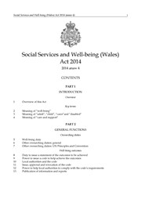
The Acts that have shaped us

Slide 3
1983: All Wales Mental Handicap Strategy
The responsibility of securing a full life– is not only the concern and responsibility of professionals – but rather one for society
Voluntary sector has a unique contribution to make in promoting acceptance.
Alongside the recognition that care must be primarily a means of stimulating, developing and widening opportunities for a fuller life, necessarily goes the acknowledgement that it must also involve a degree of adventure.”
Notes:
Methodology
The focus for the interviews included confidence, friendships. Social life and expectations for the future.

Slide 4
2001: Fulfilling the Promises
It is not enough to provide services and to promote the integration of people with learning disabilities in their communities unless these efforts help to develop independence and self-fulfilment.
The dignity and self-respect of individuals often depends on their ability to make everyday decisions and to feel that they are not only consulted but that they are listened to before decisions are made for them
Ultimately, community living is about personal lifestyles and the networks of friendships, support arrangements and opportunities that are available to individuals
Notes:
Methodology
The focus for the interviews included confidence, friendships. Social life and expectations for the future.

Slide 5
2016: Social Services & Wellbeing Act
The relationship between the person providing the services and the person receiving the service must be an equal one
Those funding, designing and providing services should expect adults to know what is best for themselves
Make sure communities have a chance to offer their knowledge and experience

Slide 6
Valued & Visible
The responsibility of securing a full life – is not only the concern and responsibility of professionals – but rather one for society (1983)
It is not enough to provide services and to promote the integration of people with learning disabilities in their communities unless these efforts help to develop independence and self-fulfilment. (2001)
Make sure communities have a chance to offer their knowledge and experience (2016)

Slide 7
Active Inclusion
Visibility, Value & Respect
Benign Benevolence
Fearful Ignorance

Slide 8
What do we need from Regional Partnership Boards in Wales?
A Change in relationships between funders & organisations which support people with a learning disability – understanding your partners
A Clearer Joint Understanding of how the SSWBA impacts on designing & commissioning of services.
Long term partnerships with clear shared outcomes.
People with a learning disability, their families & organisations which support them as as key partners in defining outcomes & service design.
Service design which help change public attitudes as a long term outcome

Slide 9
How do we measure our impact?
Shared Adapted measurement tools
Shared Wellbeing tools
Service monitoring which measuring projects which enhance status & value
Understanding & defining the steps needed to
Increase Visibility/Value
Reduce need for paid support
Engage Communities in a journey to Active Inclusion

Slide 10
Understanding the views of people with a learning disability, parents, communities & commissioners Security & safety Adventure & personal challenge Visibility in your local community Valued & Respect Continuity of support Friendships and Relationships Affordability

Slide 11
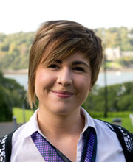
Research, Evaluation & Monitoring
Daron Owen
PhD Researcher

Slide 12
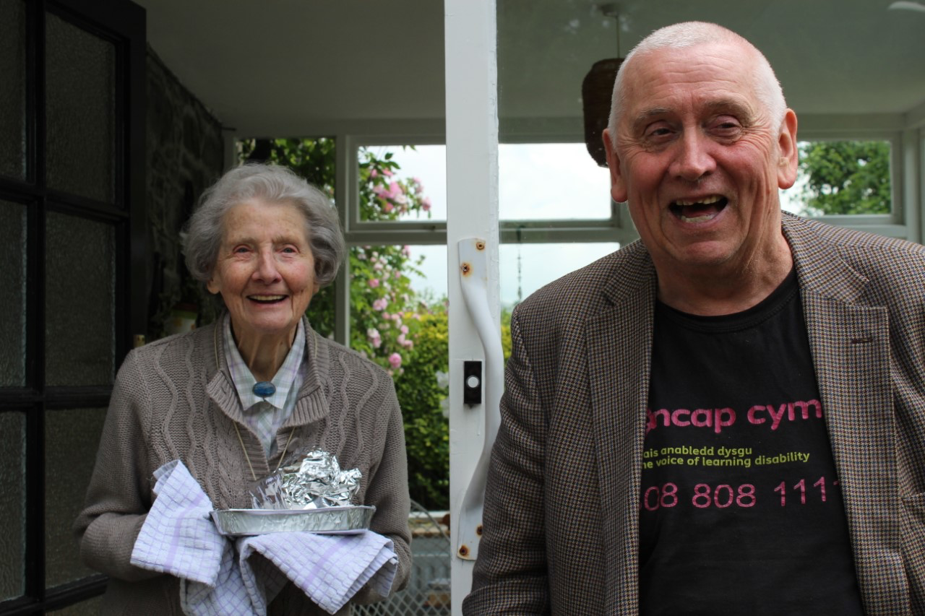
It makes me feel good
to help people around here
Jeremy 62

