Slide 1
Introduction and General Functions Overview
Notes:
This overview forms part of the suite of learning materials that have been developed to support the implementation of the Social Services and Well-being (Wales) Act 2014 . These materials summarise and explain the codes of practice or statutory guidance that underpin the Act and are designed to help those involved in care and support services to understand and implement it.
This presentation gives a very brief summary of the Act as a whole and an overview of the general functions of the Act under Part 2, including the well-being and other overarching duties. It is intended for anyone who would like to know more about Part 2 of the Act.
Note that there is also a full presentation and other more in-depth learning material on this topic area.

Slide 2
Introduction
The Social Services and Well-being (Wales) Act came into effect on 6 April 2016 and builds on the policy set out in Sustainable Social Services for Wales: A Framework for Action
It repeals and replaces many previous laws
It covers adults, children and carers
People
Well-being
Prevention
Collaboration
Notes:
[FACILITATORS NOTE: this slide has animation. The bullets on the left appear when the slide opens. The first click will show the box and first bullet point within the box (People). The second click will bring in the second bullet point (Well-being), etc]
The Act received Royal Assent on 1 May 2014 and came into force on 6 April 2016. It builds on the White Paper ‘Sustainable Social Services for Wales: A Framework for Action’ to modernise the law for care and support in Wales.
The Act aims to reform and simplify the law: it repeals many previous laws and guidance relating to care and support and replaces them with this Act.
It brought in new duties for local authorities, local health boards and other public bodies, and covers adults, children and carers.
Why do we need it? It’s often been said that we are not helping people early enough, or stopping problems arising: this means that when people finally do get care it is more intensive and costly. Shown in the box are the key principles that underpin the design of the Act that try to overcome these problems:
The Act aims to change the way people’s care and support needs are met – putting an individual, and their needs, at the centre of their care and /or support and giving them a voice in, and control over, reaching the personal outcomes goals that matter to them.
Central to the Act is the concept of well-being – helping people to maximise their own well-being.
The Act attempts to rebalance the focus of care and support to prevention and earlier intervention – increasing preventative services within the community to minimise the escalation of needs to a critical level.
Collaboration – strong partnership working between organisations and co-production with people needing care and /or support is a key focus of the Act.
These principles will enable people to be at the centre of their care and support and ensure their well-being will be central to any decisions made about their lives.

Slide 3
The Parts of the Act
1. Introduction
2. General Functions
3. Assessing the Needs of Individuals
4. Meeting Needs
5. Charging and Financial Assessment
6. Looked After and Accommodated Children
7. Safeguarding
8. Social Services Functions
9. Co-operation and Partnership
10. Complaints and Advocacy
11. Miscellaneous and General
Notes:
The Act is made up of 11 parts and they all, except the first part, have regulations or codes of practice or statutory guidance that underpin them and give more detail. The first part gives an overview of the whole Act and defines some key terms such as ‘carer’.
Part 2 is covered in this overview. It includes the well-being and other overarching duties, and requirements to undertake a population assessment and provide preventative services and an information, advice and assistance services, as well as the duty to for local authorities to promote social diverse forms of delivery of services.
Part 3 defines the circumstances in which an authority must assess a person’s needs for care and support or a carer’s needs for support, and how assessments are carried out.
Part 4 describes the national eligibility criteria and how people’s needs are to be met.
Part 5 identifies the circumstances in which a local authority may charge for providing or arranging care and /or support for individuals or preventative services.
Part 6 sets out local authority responsibilities under the Act for looked after children, arrangements for leaving care, and secure accommodation for children.
Part 7 brings in new, statutory safeguarding arrangements, including a duty to report an adult or child at risk and for authorised officers to apply to the court for an “adult protection and support order”.
Part 8 specifies the social services functions of local authorities and provides grounds for intervention by Welsh Ministers where a local authority is failing in those functions.
Part 9 requires local authorities to promote co-operation with their relevant partners, and imposes a duty on their relevant partners to co-operate with – and provide information to – the local authorities. It also establishes Regional Partnership Boards.
Part 10 provides for complaints about social services and new rights to complain about private social care and palliative care. It also provides for advocacy services to be made available to enable individuals to engage and participate in their care and support, including the requirement to arrange an independent professional advocate in certain circumstances.
Part 11 unsurprisingly covers a variety of things including the duty of local authorities to meet the care and support needs of individuals in the secure estate.

Slide 4
What is the Act trying to achieve: prevention
More well-being support
Preventative
Intensive
Increased level of early intervention / prevention services
spectrum of care and support
Better access to information, advice & community resources
Less need for intensive managed support
Notes:
This is a diagrammatic representation of the principles and assumptions underpinning the Act.
The key assumption is that through an increased level of effective earlier intervention / preventative services, including better access to information and advice for everyone, and well-being support for those that need some help (the left hand side of the care and support spectrum), more people will be able to be supported without need for managed intensive care and support. Hence the dotted line moves to the right: fewer citizens will need care and support planning for managed, complex care.
The Act attempts to rebalance the focus of care and support to prevention and earlier intervention – increasing preventative services within the community to minimise the escalation of needs to a critical level. The Act also recognises carers’ vital input and aims to help them maintain their caring role, which of course will often help the people they care for to postpone or delay the need for more managed, complex care.

Slide 5
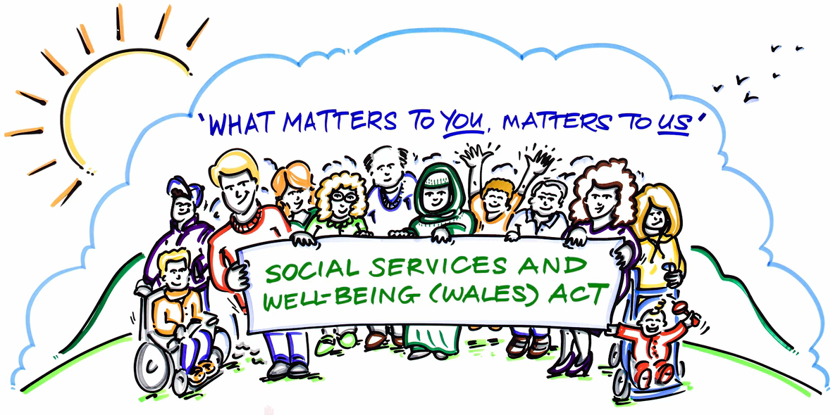
What is the Act trying to achieve: collaboration
Notes:
The Act requires a culture change from the way in which services have often been provided, to an approach based on collaboration, and an equal relationship between practitioners and people who need care and support and carers who need support.
This is a still from a short animated film developed by the SSIA called ‘What Matters to You, Matters to Us’. It shows that to give people a strong voice in, and real control over, their care and support you need to tap into the resources that people themselves, their families and the community, have. People – children, young people, adults and carers, their families and their communities – are rich assets and have skills, expertise and capabilities. Working with people will be key to delivering well-being and unlocking the potential for creativity which will make better and more effective use of all of the available resources.
For this to happen it will require different types of interaction between practitioners and individuals needing care and support. For example, professionals / practitioners will need to assist people to think about ‘what sort of life I would like and what needs to change to make this happen?’ This will require a shift from thinking ‘we do to’ the individual requiring care and support to ‘we do with’ the individual who may need care and support or carer who may need support. What matters are the outcomes that are important to the individual.
The Act is also trying to achieve greater collaboration between organisations working with people with care and /or support needs. There are new duties in the Act for local authorities, local health boards and other public bodies to co-operate and work across service boundaries in partnership.

Slide 6
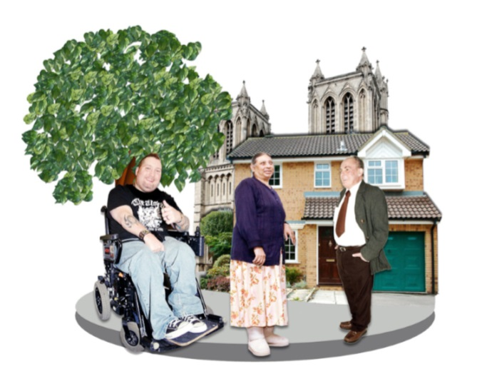
Well-being
Responsibility for well-being must be shared with people who have needs for care and / or support
A person exercising functions under this Act must seek to promote the well-being of people who need care and support and carers who need support
Notes:
[FACILITATORS NOTE: this slide has animation. The picture and quote box will show when the slide opens. The first click will show the top right sentence]
Central to the Act is the well-being duty. People have a responsibility for their own well-being supported by their families, friends and communities. However, people may also need support to ensure that they achieve well-being. Professionals and agencies are there to provide some of this support.
Part 2 of the Act requires “any persons exercising functions under the Act to seek to promote the well-being of people who need care and support and carers who need support.” This overarching duty applies to organisations and their practitioners when, for instance, carrying out assessment or providing an information and advice service.
In promoting well-being you have to not only think about people who need care and / or support now, but those whose needs aren’t eligible or who might have needs in the future. Promoting well-being, therefore, includes focusing on preventing the need for care and support and stopping people’s needs from escalating, as well as providing people with the information, advice and assistance they need to take control over their day-to-day life.
Practitioners must look at what people can contribute in achieving their well-being and empower them to contribute to achieving their own well-being with the appropriate level of care and support. This will involve building on people’s resources, including people’s strengths, abilities and families and communities.
Well-being is defined with 8 common aspects (e.g. suitability of living accommodation) and 2 more that are specific to either children (e.g. a child’s physical, intellectual, emotional, social and behavioural development) or adults (e.g. participation in work). While all aspects of well-being in the definition have equal importance, it is likely that some aspects of well-being will be more relevant to one person than another. Practitioners should therefore adopt a flexible approach that allows for a focus on which aspects of well-being matter most to the individual concerned and co-produce solutions with people themselves.

Slide 7
Other overarching duties
Adults best placed to judge their own well-being
Views, wishes and feelings of those with parental responsibility
Promoting independence
Respecting dignity
Participation
Characteristics, culture and belief
Views, wishes and feelings of the individual
Upbringing of the child by the child’s family
Notes:
As well as the well-being duty there are other overarching duties that underpin the Act, and the local authority must take steps to ensure that all services are delivered in a way which complies with these duties. These duties apply to organisations and their practitioners when dealing with a person who may have needs for care and support or a carer with support needs, even if it has not been established that the individual has such needs or would be eligible.
Four of these overarching duties apply in all cases, whether an adult or a child. The duty to:
Ascertain and have regard to the individual’s views, wishes and feelings, in so far as is reasonable practicable
Have regard to the importance of promoting and respecting the dignity of the individual
Have regard to the importance of providing appropriate support to enable the individual to participate in decisions that affect them to the extent that it is appropriate in the circumstances, particularly where the individual’s communication is limited for any reason
Have regard to the characteristics, culture and beliefs of an individual, including language
Two overarching duties apply specifically to adults, which are a) to begin with the presumption that they are best placed to judge their own well-being and b) to have regard to the importance of promoting their independence where possible. Promoting independence should be viewed in the context of the Framework for Action on Independent Living which is based on the social model of disability i.e. it recognises that people with impairments are disabled by the barriers that commonly exist in a society. If fully realised, the social model would mean that disabled people were able to participate fully in society, and the impact of their impairment would be substantially reduced.
In relation to children there is also the duty to a) promote the upbringing of the child by the child’s family, in so far as doing so is consistent with the well-being of the child and b) for under 16s, to ascertain and have regard to the views, wishes and feelings of those with parental responsibility, in so far as is practical and consistent with the child’s well-being.
Practitioners also have to have regard to human rights. Note that the UN Principles for Older Persons, Convention on the Rights of Disabled People, and Convention on the Rights of the Child, as well as the European Convention of Human Rights also apply.

Slide 8
Population assessment
Assessments
Data
Outcomes framework
Planning
Assessment of needs
Identification of range and level of services
Population assessment report
INFORM
INFORMS
INFORMS
INFORMS
Stakeholders
Publication
Notes:
[FACILITATORS NOTE: this slide has animation. The middle, section will show when the slide opens. The first click will bring in the pink blocks top left and middle. The second click will bring in the blocks bottom left. The third click will bring in the dark pink block bottom right. The fourth and final click will bring in the block top right]
As shown in the arrow diagram here, local authorities and local health boards must jointly assess the extent to which there are people who need care and support, or carers who need support, in the local area.
They should then identify the range and level of services required to meet those needs. Specifically, they should assess the current range and level of preventative services and whether these are sufficient. They should also outline the actions required to deliver the range and level of services identified as necessary through the medium of Welsh i.e. how well do those services match the Welsh language community profile?
They must use this to produce, and publish, one population assessment report per local government electoral cycle.
The population assessment must be informed by a range of information such as individuals’ assessments, local data and the performance measures that are part of the national outcomes framework. It should also be informed by engagement with a wide range of citizens, stakeholders and partners such as service providers.
Note that the population assessment links to and supports other requirements under the Act. For example, it will inform the nature of the local information, advice and assistance service required.
Finally, the population assessment report must be taken into account as part of broader integrated planning frameworks, and hence it should inform the Integrated Medium Term Plan (IMTP), health and well-being strategies and homelessness strategy, etc.

Slide 9
Preventative services
Local authorities must ensure a range and level of preventative services which:
Help prevent, delay or reduce needs for care and support
Promote the upbringing of children by their family
Minimise the effect of people’s disabilities
Help prevent abuse or neglect
Enable people to live as independently as possible
Reduce the need for: care or supervision orders; criminal proceeding against children; taking children into local authority care or secure accommodation
Local health boards must also take a preventative approach that helps to achieve these aims
Notes:
[FACILITATORS NOTE: this slide has animation. The first paragraph will show when the slide opens. The first click will show the first bullet point, and the second click the second bullet point etc.]
Prevention is a key aim of the Act and Part 2 requires local authorities to provide or arrange for the provision of a range of preventative services, which they think will:
Contribute towards preventing or delaying the development of people’s needs for care and support, and reduce the needs for care and support of people who have needs
Promote the upbringing of children by their families, where that is consistent with the well-being of children
Minimise the effect on disabled people of their disabilities
Contribute towards preventing people from suffering abuse or neglect
Enable people to live their lives as independently as possible, and
Reduce the need for proceedings for care or supervision orders under the Children Act 1989, or criminal proceedings against children, or other proceedings which might lead to children being placed in local authority care, or avoids the need for children to be placed in secure accommodation.
Clearly this links to the duty to undertake a population assessment, which should help local authorities to identify the current range of preventative service available.
This alone is not enough. Crucially, local authorities will need to promote a culture of prevention, identify those who may benefit from preventative services, and promote re-ablement and habilitation. For example, local authorities should ensure staff are aware of the benefits of preventative services and are encouraged to consider how they can be delivered. Staff should feel empowered to work with service recipients to deal with issues preventatively.
However, prevention is wider than social services. All areas of local authorities (e.g. housing, leisure and education) and local health boards must take a preventative approach that help to achieve the bullet points above, collaborating where appropriate.

Slide 10
Promoting greater diversity of delivery
Social enterprises
Co-operatives
Third sector
User-led
Notes:
Section 16 of the Act requires local authorities to promote the development in their area of not-for-private-profit business models to provide care and support and preventative services. These models include social enterprises, co-operative organisations and arrangements, user-led services and the third sector.
Welsh Government public services policy is for greater diversity in the delivery of services through e.g. mutual and community ownership. This new requirement is about encouraging the growth and development of the range of not for private profit business models.
It is hoped that the development and promotion of not-for-private-profit business models can promote other environmental and social goals, and support innovation and creativity thereby increasing community resilience.
The duty to promote means that local authorities must take a proactive approach to planning and delivering models that will meet the well-being needs of all local people, responding to the population assessment.
Section 16 also states that local authorities must promote the involvement of people for whom services are provided in the design and operation of that provision. This means at an individual, organisational and strategic level.
For example, at a strategic level local authorities and local health boards must engage with people in the production of a population assessment report and establish a procedure for this engagement. Local authorities must strengthen the involvement of people in the commissioning and procurement of services, and ensure that providers from whom they buy services encourage and enable the involvement of their service recipients. At an individual level practitioners must take a co-productive approach.

Slide 11
Information, advice and assistance
Information and advice for all:
How the system works
The types of care and support available
How to access it
How to raise concerns about someone’s well-being
Assistance
Accessible
Notes:
[FACILITATORS NOTE: this slide has animation. The bullet points will show when the slide opens. The first click will show the box “Assistance”, the second click the box “Accessible”]
Local authorities must ensure that there is an information and advice service for all people not just those with care and support needs or in some other way known to the system.
Information is providing data to someone. Advice is exploring options with someone that are right for their particular circumstances so that they can make choices. A local authority does not have to provide all elements of this service, but as a minimum it must cover:
How the local care and support system works
The types of care and support available
How to access the care and support that is available
How to raise concerns about the well-being of someone who appears to have needs for care and support
The service needs to reach a very broad range of people. This will only be achieved through working in partnership with the local health board (LHB), wider public and local advice and information providers. In fact, under the Act, LHBs must provide the local authority with information about the care and support it provides in the area.
Information and advice is central to the promotion of well-being and early intervention. Local authorities should ensure that information and advice is given at an early stage so that people can make the best informed decision for their particular circumstance. There is an element of actively targeting the audience for information and advice.
Assistance is helping people to take the first steps to doing something with that advice. Local authorities are also required to provide assistance, if needed, to enable people to access care and support – such as helping someone to complete a form or checking that a signposted service met the person’s needs.
A key tenet of an information, advice and assistance service is that it must be provided in a manner which is accessible to the person. E.g. using a range of media, in English and Welsh, with staff appropriately trained, and materials adapted as necessary.

