Slide 1
Canllaw lleoliad gwaith
Work placement guidance
Karen Wakelin
(Gofal Cymdeithasol Cymru /
Social Care Wales)

Slide 2
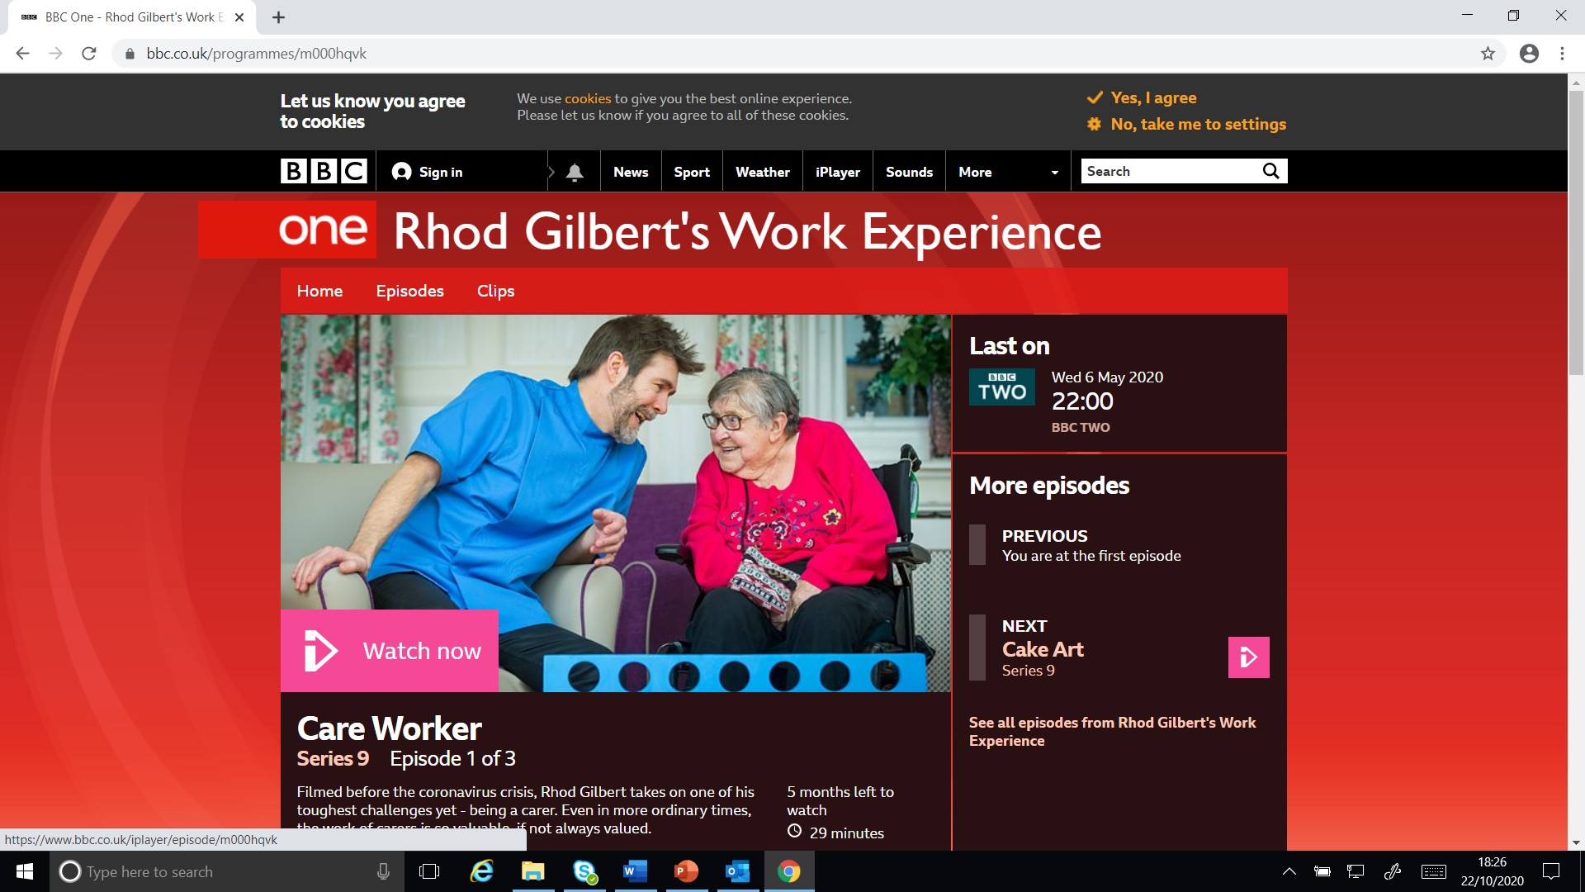
Notes:
Mae gwasanaethau iechyd, gofal cymdeithasol, gwaith chwarae, blynyddoedd cynnar a gofal plant yn ymwneud â gwneud gwahaniaeth cadarnhaol i fywydau eraill, a gydag amrywiaeth enfawr o rolau ar gael, mae hynny'n golygu ei bod yn yrfa werth chweil. Mae profiad o waith yn y gwasanaethau hyn yn hanfodol i bontio'r bwlch rhwng addysg neu hyfforddiant a byd gwaith. Ar ei orau, gall agor llygaid pobl i swyddi nad oeddent erioed wedi meddwl amdanynt, llywio penderfyniadau gyrfa a darparu profiad gwerthfawr ar gyfer ceisiadau am swydd a mynediad at addysg uwch.
Fel cyflogwyr, mae'n bosibl eich bod chi’n pendroni pam ein bod yn hyrwyddo cyfleoedd lleoliad gwaith ar adeg pan rydych chi'n wynebu'r heriau mwyaf i'n gwasanaethau iechyd, gofal cymdeithasol a gofal plant ers cyn cof.
Efallai bod llawer ohonoch wedi gwylio rhaglen deledu am brofiad gwaith Rhod Gilbert mewn cartref gofal. Fe wnaeth y rhaglen hon gymaint i godi proffil gofal cymdeithasol a'r canfyddiad o beth yw pwrpas y swydd. Dyma ychydig o ddyfyniadau Rhod o'r rhaglen:
Sgiliau isel - meddai pwy? Pe byddem yn gwerthfawrogi ein gofalwyr hyd yn oed 1% gymaint ag y dylem, honno fyddai’r swydd fwyaf buddiol y gallech ei gwneud’
‘Mae wedi bod yn fraint ac yn anrhydedd, ac yn un o’r (profiadau) anoddaf, ond un o’r goreuon’
‘Yn y dechrau, roeddwn i’n disgwyl iddo fod yn anodd, ac mae’n sicr yn anodd. Doeddwn i ddim yn disgwyl bod mor hapus, mor llawen â hyn. Doeddwn i ddim yn disgwyl i’r profiad fod gystal â hyn
Mae angen i ni ddod o hyd i ffordd o ddenu pobl i'r sector o hyd - ond fel gyrfa werthfawr o ddewis, nid oherwydd nad oes unrhyw beth arall ar gael.
Rydym wedi datblygu pecyn cymorth a fydd, gobeithio, yn eich helpu i wneud lleoliad gwaith yn brofiad cadarnhaol i chi fel cyflogwyr, i'r unigolion sy'n defnyddio eich gwasanaethau ac i'r unigolyn sy'n dod i gael profiad gwaith yn eich lleoliad.
***
Health, social care, playwork, early years and childcare services are about making a positive difference to the lives of others, with a huge range of roles available, this makes it a highly rewarding career. Experience of work in these services is crucial to bridge the gap between education or training and the world of work. At its best, it can open people’s eyes to jobs they had never thought of, inform career decisions and provide valuable experience for job applications and entry to higher education.
As employers, you may be wondering why we are promoting opportunities for work placement at a time when you are facing the biggest challenges to our health, social care and childcare services in living memory.
Many of you may have watched Rhod Gilbert’s work experience in a care home, this programme did so much to raise the profile of social care and the perception of what the job is about. A few of Rhod’s quotes from the programme are:
Low skilled, says who? If we valued our carers even 1% as much as we should, it would be the most rewarding job you could do’
‘It’s been a privilege and an honour, and one of the toughest (experiences), but one of the best’
‘I came into it expecting it to be tough, and it is tough. I didn’t expect to be this happy, this joyful. I didn’t expect it to be this rewarding’
We need to find a way to keep attracting people into the sector – but as a valued career of choice not because nothing else is available.
We have developed a toolkit which we hope will help you make work placement a positive experience for you as employers, for the individuals who use your services and for the person coming in to experience work in your setting.

Slide 3
Lleoliad gwaith
Work Placement
Beth yw lleoliad Gwaith?
Pwy sydd ei angen?
Beth yw’r buddion ar gyfer cyflogwyr?
What is work placement?
Who needs it?
What are the benefits for employers?
Notes:
Beth yw lleoliad gwaith a phwy sydd ei angen?
Gellir defnyddio profiad gwaith drwy leoliad mewn sefydliadau iechyd, gofal cymdeithasol, gwaith chwarae neu flynyddoedd cynnar a gofal plant am lawer o resymau e.e.
Cyflogwyr sydd eisiau buddsoddi yn natblygiad gweithlu'r dyfodol a'i gefnogi, gan ysgogi ac ysbrydoli pobl i weithio yn y sectorau
Disgyblion a myfyrwyr, pobl sy'n chwilio am newid mewn gyrfa neu'r rhai sy'n dychwelyd i'r gwaith i archwilio cyfleoedd gwaith, magu hyder a datblygu gwybodaeth a sgiliau sy'n eu paratoi ar gyfer gwaith yn y sectorau
Dysgwyr sy'n ymgymryd â chymwysterau ffurfiol drwy golegau Addysg Bellach, Sefydliadau Addysg Uwch, ysgolion neu ddarparwyr dysgu eraill i gymhwyso gwybodaeth a dealltwriaeth a gafwyd drwy astudio mewn amgylchedd ymarferol, a datblygu'r sgiliau sydd eu hangen i gyflawni cymhwysedd
Beth yw’r manteision i gyflogwyr?
Gall cynnig cyfleoedd lleoliad gwaith ddod â chyfoeth o fanteision i chi:
Cysylltu â chronfa bosibl o weithwyr a chyfrannu at ddatblygu’r genhedlaeth nesaf o weithlu medrus iawn
Dysgu o adborth a gwaith myfyrio dysgwyr i wella eich gwasanaeth
Adolygu safonau ac arferion yn rheolaidd i sicrhau eu bod yn gyfredol ac o ansawdd da
Hyrwyddo gwerth y sectorau, yr amrywiaeth o rolau sydd ar gael ac ysgogi pobl i weithio ym maes iechyd, gofal cymdeithasol neu ofal plant fel gyrfa o ddewis
Hyrwyddo eich gwasanaeth eich hun a'r hyn sydd ganddo i'w gynnig
Cefnogi datblygiad eich gweithlu eich hun drwy fentora
***
What is work placement and who needs it?
Experience of work through placement in health, social care, playwork or early years and childcare settings may be used for many reasons e.g:
For employers who want to invest in and support the development of the future workforce, motivating and inspiring people to work in the sectors
For pupils and students, people looking for a change in career or those returning to work to explore job opportunities, build confidence and develop knowledge and skills which prepare them for work in the sectors
For learners undertaking formal qualifications through FE colleges, Higher Education Institutes, schools or other learning providers to apply knowledge and understanding gained through study in a practical environment, and develop the skills needed to achieve competence
What are the benefits for employers?
Offering work placement opportunities can bring you a wealth of benefits:
Tapping into a potential pool of workers and contributing to the development of the next generation of a highly skilled workforce
Learning from feedback and reflection of learners to improve your service
Routinely reviewing standards and practices to ensure they are up to date and of good quality
Promoting the value of the sectors, the range of roles available and motivating people to work in health, social care or childcare as a career of choice
Promoting your own service and what it has to offer
Supporting the development of your own workforce through mentoring

Slide 4
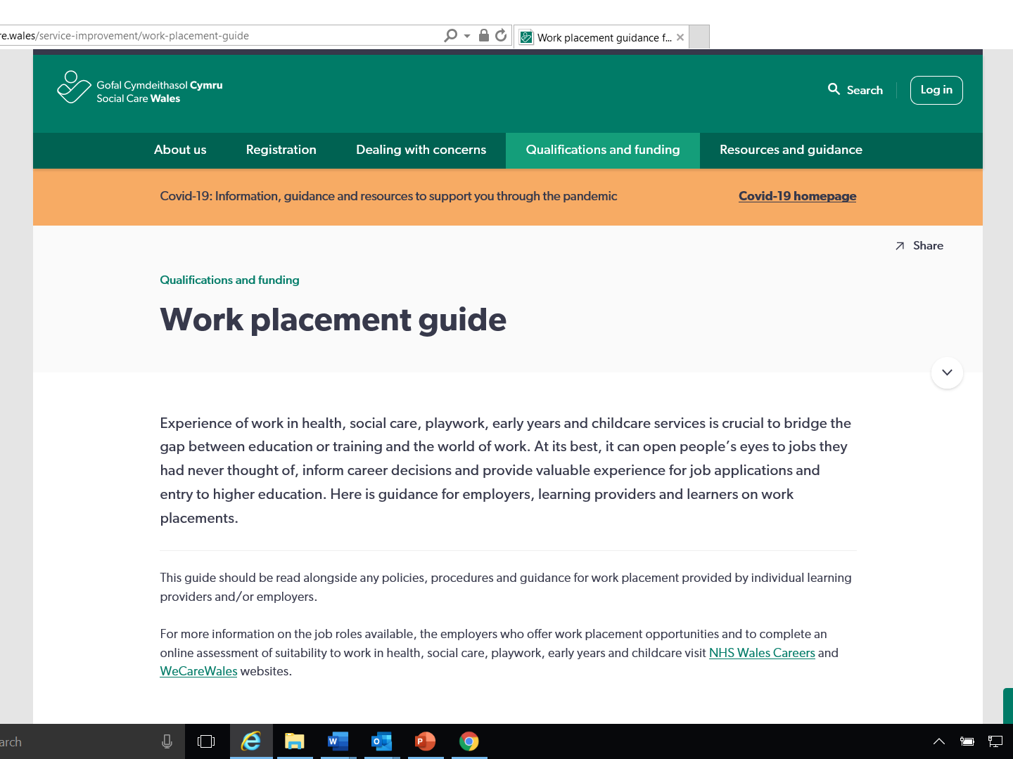

Slide 5
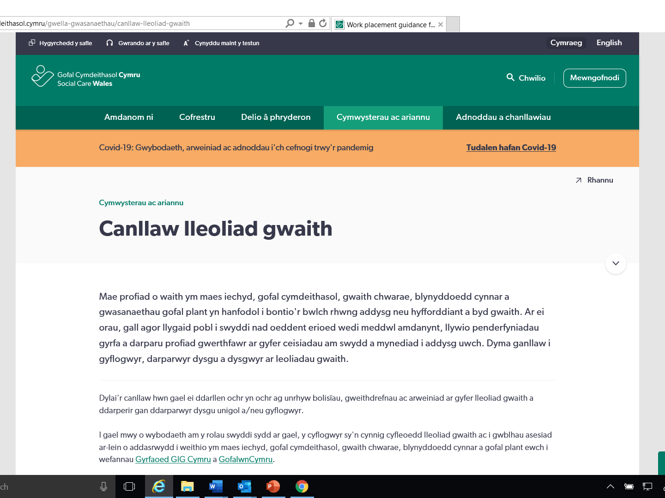

Slide 6
Strwythur y canllaw
Structure of the guide
Mae’r canllaw wedi’i rhannu i dair rhan
Cyflogwyr
Darparwyr dysgu
Dysgwyr
The guide is divided into three parts
Employers
Learning providers
Learners
Notes:
Er hwylustod, mae'r canllaw wedi ei rannu'n dair rhan - cyflogwyr, darparwyr dysgu a dysgwyr.
Mae pob rhan yn cynnwys yr un wybodaeth sydd wedi ei theilwra ar gyfer y gynulleidfa. Mae'n bosibl yr hoffech chi edrych ar yr wybodaeth a ddarperir i ddysgwyr yn ogystal â'r rhan a ddatblygwyd ar eich cyfer, gan y bydd hyn yn eich helpu i ddeall disgwyliadau
***
For ease of use, the guide has been divided into three parts – employers, learning providers and learners.
Each part contains the same information which has been tailored for the audience. You may want to look at the information provided to learners as well as the part developed for you, as this will help you understand expectations

Slide 7
Saith adran
Seven sections
Each part has seven sections
Mae gan bob rhan saith adran
Notes:
Mae saith rhan ym mhob adran sy'n darparu gwybodaeth fanwl am sut i baratoi ar gyfer lleoliadau gwaith a darparu adborth ar ôl gorffen.
Byddwn yn edrych ar bob un o'r adrannau hyn ychydig yn fanylach nesaf
***
Each part has seven sections providing detailed information on how to prepare for work placements to providing feedback when they have finished.
We will look at each of these sections in a little more detail next

Slide 8
Adran 1
Section 1
Buddion lleoliad gwaith
The benefits of work placement
Notes:
Fel yr amlinellwyd eisoes, gall cynnig cyfleoedd lleoliad gwaith ddod â chyfoeth o fanteision yn ei sgil. Gall gweithio yn y sectorau iechyd, gofal cymdeithasol, gwaith chwarae neu flynyddoedd cynnar a gofal plant fod yn werth chweil ac yn heriol - gall rhoi cyfle i ddysgwyr roi cynnig ar ddysgu yn y swydd hyrwyddo gwerth y sectorau ac ysgogi pobl i weithio gyda chi fel gyrfa o ddewis.
Gallant hefyd roi cyfle i chi fyfyrio ar arferion eich lleoliad gwaith a sicrhau bod eich safonau'n gyfredol ac o ansawdd da
***
As already outlined. offering work placement opportunities can bring a wealth of benefits. Working in the health, social care, playwork or early years and childcare sectors can be both rewarding and challenging – giving learners an opportunity to try out and learn on the job can promote the value of the sectors and motivate people to work with you as a career of choice.
They can also give you an opportunity to reflect on the practice of your work setting and make sure your standards are up to date and of good quality

Slide 9
Adran 2
Section 2
Paratoi ar gyfer lleoliad gwaith
Preparing for work placement
Notes:
Mae paratoi ar gyfer lleoliadau gwaith yn un o'r agweddau pwysicaf ar gynnig y cyfleoedd hyn. Gall bod yn glir ynghylch y mathau o weithgareddau y gall ac na all dysgwyr fod yn rhan ohonynt gael gwared ar y risg o gamdybiaethau. Bydd darparu gwybodaeth sy'n helpu dysgwyr i ddeall yr hyn a ddisgwylir ganddynt a'r hyn y gallant ei ddisgwyl gennych yn cynorthwyo proses esmwyth a phrofiad lleoliad cadarnhaol
***
Preparing for work placements is one of the most important aspects of offering these opportunities. Being clear about the types of activities learners can and cannot be involved in can remove the risk of misconceptions. Providing information which helps learners understand what is expected of them and what they can expect of you will support a smooth process and positive placement experience

Slide 10
Adran 3
Section 3
Cael y mwyaf o gyfleon lleoliad gwaith
Getting the most out of work placement opportunities
Notes:
Bydd buddsoddi mewn cyfleoedd lleoliad gwaith yn golygu gwaith cynllunio gofalus ac mae'n bwysig eich bod yn gallu sicrhau'r buddion mwyaf posibl i'ch lleoliad gwaith.
Mae’n bosibl yr hoffech gynnig cyfle i'r dysgwr ymweld â'r safle cyn i'w leoliad ddechrau - bydd hyn yn ei helpu i wybod beth i'w ddisgwyl; mae’n bosibl y byddwch chi hefyd eisiau cynnal cyfweliad i weld a ydyn nhw'n addas. Os yw'n anodd gwneud hyn wyneb yn wyneb o ganlyniad i gyfyngiadau Covid-19, meddyliwch am roi taith dywys ddigidol iddynt gyda chyfleoedd i ddweud helo wrth weithwyr eraill.
Bydd anghenion dysgu pob unigolyn yn wahanol, yn dibynnu ar eu rheswm dros ymgymryd â'r lleoliad gwaith - er enghraifft, ennill cymhwyster galwedigaethol, rhagflas i bobl ifanc yn yr ysgol, meithrin sgiliau a hyder y rhai sy'n chwilio am gyflogaeth yn eich sector. Mae'n bwysig bod yn glir ynghylch eu hamcanion a'r hyn y gallwch ei gynnig i sicrhau bod cyfatebiaeth dda.
Mae nifer o bethau y dylech eu hystyried ac rydym wedi darparu rhestr wirio a fydd o gymorth. Un o'r pwysicaf yw dyrannu mentor a fydd ar gael i gefnogi dysgwr drwy gydol ei leoliad gyda chi. Gall y mentor gynorthwyo drwy sicrhau bod y dysgwr yn deall yn glir beth yw’r disgwyliadau, gan ddarparu adborth, sicrwydd ac anogaeth.
***
Investing in work placement opportunities will take careful planning and it is important you are able to maximise the benefits for your work setting.
You may want to offer the learner a chance to visit the setting before their placement starts – this will help them know what to expect; you may also want to conduct an interview to see whether they are suitable. If it is difficult to do this face to face as a result of Covid-19 restrictions, think about giving them a digital guided tour with opportunities to say hello to other workers.
Each person’s learning needs will differ depending on their reason for undertaking the work placement, for example, gaining a vocational qualification, a taster for young people in school, building the skills and confidence of those looking for employment in your sector. It is important to be clear about their objectives and what you can offer to make sure there is a good match.
There are a number of things you should consider and we have provided a checklist which will help. One of the most important is the allocation of a mentor who will be available to support a learner for the duration of their placement with you. The mentor can support by making sure the learner is clear about any expectations, providing feedback, reassurance and encouragement.

Slide 11
Adran 4
Section 4
Cwrdd â chanllawiau ar gyfer rheoleiddio, safonau a deddfau
Meeting requirements for regulations, standards and legislation
Notes:
Mae'r adran hon yn darparu gwybodaeth bwysig am reoliadau, safonau a deddfwriaeth y mae'n rhaid i chi eu bodloni - er enghraifft, diogelu, iechyd a diogelwch a diogelu data a chyfrinachedd
***
This section provides important information on regulations, standards and legislation you must meet such as safeguarding, health and safety and data protection and confidentiality

Slide 12
Adran 5
Section 5
Anghenion cwrs arbennig ar gyfer lleoliad gwaith
Specific course requirements for work placements
Notes:
Pan fydd dysgwyr yn ymgymryd â lleoliad gyda chi fel rhan o gwrs neu gymwysterau, bydd gofynion penodol y bydd angen iddynt eu bodloni i ddatblygu eu harfer.
Mae'n bwysig eich bod yn siarad â'r darparwr dysgu sy'n trefnu'r lleoliad gwaith i sicrhau y gallwch ddarparu digon o gyfleoedd i'r dysgwr ddatblygu a bod ei ymarfer yn cael ei asesu.
***
Where learners are undertaking placement with you as part of a course or qualifications, there will be specific requirements they will need to meet to develop their practice.
It is important for you to talk to the learning provider arranging the work placement to make sure you can provide sufficient opportunities for the learner to develop and have their practice assessed.

Slide 13
Adran 6
Section 6
Rhoi adborth
Providing feedback
Notes:
Gall adborth cadarn, adeiladol a chlir helpu dysgwyr i ddatblygu a hefyd rhoi cyfle i gyflogwyr fyfyrio ar eu harfer. Rydym wedi darparu templed a fydd yn eich helpu i feddwl am y ffordd orau o wneud hyn.
Yn anffodus, mae’n bosibl y bydd adegau pan fydd angen i chi ddarparu adborth negyddol os ydych chi'n poeni am arfer, ymddygiad neu addasrwydd dysgwyr i weithio yn y sector. Sicrhewch eich bod wedi cytuno ar brosesau ar gyfer rhoi gwybod am y pryderon i'r darparwr dysgu, gan gynnwys stopio'r lleoliad os oes angen.
***
Robust, constructive and clear feedback can help learners develop and also provide an opportunity for employers to reflect on their practice. We have provided a template which will help you think about the best way to do this.
Unfortunately, there may be times where you need to provide negative feedback if you are concerned about the practice, behaviour or the suitability of learners to work in the sector. Make sure you have agreed processes for reporting concerns to the learning provider including stopping the placement if necessary.

Slide 14
Adran 7
Section 7
Adnoddau a thempledi
Resources and templates
Notes:
Mae'r adran hon yn cynnwys nifer o dempledi ar gyfer rhestrau gwirio a chytundebau lleoliadau gwaith a allai fod yn ddefnyddiol i chi.
***
This section contains a number of templates for checklists and placement agreements which you may find helpful.

Slide 15
Syniadau ar gyfer genud lleoliadau yn ‘Covid safe’
Top tips for making placements ‘Covid safe’
Asesiad risg
Hyfforddiant cyn lleoliad ar Atal a Rheoli Heintiau (IPC)
Lleoliadau hirach yn hytrach nag ychydig o ddyddiau’r wythnos
Arolwg iechyd a chymryd tymheredd
Ymgymryd â thasgau a gweithgareddau
Risk assessment
Pre-placement training on Infection Prevention and Control (IPC)
Block placements rather than a couple of days a week
Health questionnaires and temperature testing
Activities and tasks undertaken
Notes:
Dylid cwblhau asesiad risg Covid ar gyfer unrhyw un sy'n dod ar leoliad gyda chi. Meddyliwch am yr hyn y byddech chi'n ei wneud pe bai gennych chi aelod newydd o staff yn dechrau gyda chi a chymhwyso'r un disgwyliadau i ddysgwyr ar leoliad.
Hyfforddiant cyn-lleoliad i sicrhau eu bod yn deall sut mae'n rhaid iddynt ymddwyn yn y lleoliad - er enghraifft, cadw pellter cymdeithasol, golchi dwylo a defnyddio offer diogelu personol
Lleoliadau bloc ar gyfer myfyrwyr sy'n cwblhau cymwysterau yn lle cwpl o ddiwrnodau'r wythnos i leihau nifer yr ymwelwyr yn eich lleoliad
Defnyddio holiaduron iechyd safonol e.e. a yw'r unigolyn wedi profi neu wedi bod mewn cysylltiad ag unrhyw un sydd â symptomau neu sydd wedi profi'n bositif, a ydynt wedi bod dramor neu i ardal risg uchel yn ystod y 14 diwrnod diwethaf ac ati, a chymryd eu tymheredd cyn iddynt fynd i mewn i'r adeilad bob dydd
Meddwl am risgiau sy'n gysylltiedig â thasgau neu weithgareddau y gallent fod yn ymgymryd â nhw tra byddant ar leoliad a gwneud yn siŵr bod y rhain yn risg isel yn hytrach na risg uchel lle bynnag y bo modd.
***
A Covid risk assessment should be completed for anyone coming on placement with you, think about what you would do if you had a new member of staff starting with you and apply the same expectations to learners on placement.
Pre-placement training to make sure they understand how they must behave in the setting such as social distancing, hand washing and the use of PPE
Having block placements for students completing qualifications instead of a couple of days a week to reduce footfall through your setting
Using standard health questionnaires e.g. has the person experienced or been in contact with anyone who has symptoms or has tested positive, have they been abroad or into a high risk area in the last 14 days etc. and taking their temperature before they enter the building each day
Think about any risks associated with tasks or activities they may be undertaking whilst on placement and make sure that these are low risk rather than high risk wherever possible

Slide 16
Beth arall?
What else?
Gofalwn Cymru https://www.gofalwn.cymru/
Rhannwch eich profiadau
https://gofalcymdeithasol.cymru/amdanom-ni/cysylltu
Wecare Wales https://www.wecare.wales/
Share your experiences
https://socialcare.wales/about-us/contact
Notes:
Os ydych chi eisiau hysbysebu cyfleoedd am leoliadau gwaith sydd ar gael yn eich lleoliad gwaith, mae Gofalwn.Cymru yn datblygu swyddogaeth y gellir ei defnyddio i adael i ddarparwyr dysgu a dysgwyr wybod am y rhain.
Os penderfynwch gynnig cyfleoedd lleoliad gwaith, rhannwch eich profiadau gyda ni - rydym yn awyddus i gynnwys tystebau cyflogwyr ac astudiaethau achos bywyd go iawn a fydd yn dod â'r pecyn cymorth hwn yn fyw.
***
If you want to advertise placement opportunities available in your work setting, Wecare Wales is developing a function which can be used to let learning providers and learners know about these.
If you decide to offer placement opportunities, please share your experiences with us – we are keen to include employer testimonials and real life case studies which will bring this toolkit to life.

Slide 17
Ystafelloedd i drafod
Break out room
Beth yw’r buddiannau a beth allai fod yn heriol wrth gynnig lleoliadau gwaith?
Beth am atebion i’r heriau?
What are the benefits and what may be the challenges of offering placement opportunities?
Solutions to challenges?

