Slide 1
Safeguarding Overview
Notes:
This overview forms part of the suite of learning materials that have been developed to support the implementation of the Social Services and Well-being (Wales) Act 2014. These materials summarise and explain the codes of practice or statutory guidance / regulations that underpin the Act and are designed to help those involved in care and support services to understand and use it.
This presentation is an overview of safeguarding. It is intended for anyone who would like to know more about Part 7 of the Act.
Note that there is also a full presentation and other more in-depth learning material on this topic area.

Slide 2
What is covered
Overarching duties and links to other parts of the Act
Part 7 of the Act: Well-being and vision for safeguarding
Safeguarding Boards
Children’s Pathway
Adults Pathway
Notes:
This overview presentation sets out the areas of the Act, regulations and statutory guidance that relate to safeguarding.
There is a whole section on safeguarding in Part 7 of the Act, but there are also other parts of the Act that relate to safeguarding.
The safeguarding Part of the Act is underpinned by the overarching duties of the Act.
This overview provides a brief introduction to all these areas, including safeguarding boards and adults and children’s pathways.
Safeguarding is everyone’s business. Practitioners in all agencies need to recognise and act when they identify children and adults at risk.
Practitioners in adults’ and children’s services in local authorities (or organisations they have delegated functions to) and practitioners in relevant partner agencies – police, probation, youth offending teams, local health boards and NHS trusts – need to know what must and should be done to safeguard people.

Slide 3
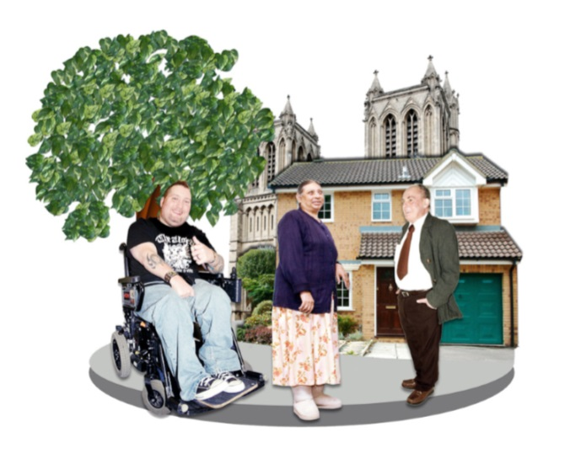
Well-being and overarching duties
“The Act will transform the way social services are delivered, promoting people’s independence to give them a stronger voice and control.”
A person exercising functions under this Act must seek to promote the well-being of people.
Well-being includes protection from abuse and neglect
You also need to follow the other overarching duties:
Participation
Dignity
Views, wishes, feelings
Culture
Notes:
[FACILITATORS NOTE: this slide has animation. The picture and quote boxes will show when the slide opens. The first click will show the bottom left section]
The Act changed the way people’s care and support needs are met. The vision of care and support under the Act is one where individuals have a voice in, and real control over, reaching the personal outcome goals that matter to them.
Central to the Act is the well-being duty. People have a responsibility for their own well-being supported by their families, friends and communities. However, they may also need support from practitioners to ensure that they achieve well-being.
Part 2 of the Act requires “any persons exercising functions under the Act to seek to promote the well-being of people who need care and support, and carers who need support.” This overarching duty applies to organisations and their practitioners when, for instance, carrying out assessment or providing information and advice.
In the Act well-being is defined with eight common aspects, one of which is protection from abuse and neglect. In relation to a child, well-being also includes: their physical, intellectual, emotional, social and behavioural development; and their welfare – ensuring that they are kept safe from harm. Safeguarding is part of helping people to live life to the full, not just stopping abuse, neglect and harm.
There are some other overarching duties in the Act. When exercising functions under the Act, practitioners have to: ascertain and have regard to the individual’s views, wishes and feelings (and for under 16s, those with parental responsibility, if practical and consistent with the child’s well-being); support them to participate in decisions and to communicate; promote and respect their dignity; and have regard to the characteristics, culture and beliefs of the individual. Supporting people to participate, includes considering whether advocacy support is necessary.
For adults specifically there is also the duty to a) begin with the presumption that an adult is best placed to judge their own well-being and b) to have regard to the importance of promoting their independence where possible.
For children specifically there is also the duty to promote the upbringing of the child by the child’s family, in so far as doing so is consistent with the well-being of the child. This means seeking to de-escalate the need for formal intervention in their lives and to strengthen the capacity of families to care for their children wherever it is safe to do so.

Slide 4
Human rights
Notes:
The overarching duties of the Act include human rights. A key part of practitioners’ role under the Act is to empower people through helping them to assert these rights. Safeguarding should happen in the context of human rights, dignity, and individual empowerment.
Under the Act, you need to have regard to the United Nations Principles for Older Persons. This includes respect for older people’s dignity, beliefs, needs and privacy and for the right to make decisions about their care and the quality of their lives. You need to have regard to the United Nations Convention on the Rights of the Child. This includes the right to life, survival and development, and protection from violence, abuse and neglect. You also need to have regard to the United Nations Convention on the Rights of Disabled People (UNCRDP). The code of practice for Part 2 of the Act also points out that public authorities must not act in a way that is incompatible with rights under the European Convention on Human Rights. This includes the right not to be subjected to inhuman or degrading treatment and the right to liberty and security.
Abuse, neglect and harm are human rights violations and can mean that it is harder for people to exercise their human rights. They can violate the right to freedom from inhuman or degrading treatment, or they can ultimately violate the right to life. Abuse, neglect and harm can also mean that people lose other human rights such as the right to education for children. Sometimes abuse consists of slavery or forced labour.
Over-protective services can result in curtailing other rights including the right to liberty and security; the right to a fair hearing; and the right to respect for private and family life, home, and correspondence.

Slide 5
Links to other Parts of the Act
1. Introduction
2. General functions
Prevention of abuse & neglect and harm
How to raise concerns
3. Assessing the needs of individuals
Duty to assess if person at risk
4. Meeting needs
Duty to meet needs if necessary to protect
5. Charging and financial assessment
6. Looked after and accommodated children
Duty to safeguard well-being of looked after children
7. Safeguarding
8. Social services functions
9. Co-operation and partnership
Co-operation to protect
10. Complaints and advocacy
11. Miscellaneous and general
Research into Safeguarding Boards
Notes:
Part 7 of the Act relates to safeguarding and has its own statutory guidance and regulations. However, other parts of the Act link to the duty to protect people from abuse and neglect, and to protect children from harm.
Part 2 links prevention, information and advice to safeguarding. Section 15 of the Act requires local authorities to provide or arrange for the provision of a range of preventative services, including ones which will “contribute towards preventing people from suffering abuse or neglect. Section 17 says that provision of information, advice and assistance must include how to raise concerns about the well-being of a person who appears to have needs for care and support.”
Part 3 links assessment to safeguarding. Sections 20 and 22-23 say that if an adult, young person or child refuses an assessment, this does not discharge a local authority from its duty to assess “if the local authority suspects that the adult is experiencing or at risk of abuse or neglect, or the local authority suspects that the young person / child is experiencing or at risk of abuse, neglect or other kinds of harm.”
Part 4 links meeting needs to safeguarding. Sections 35 and 37 explain that if an adult or child has needs that don’t meet the eligibility criteria, the local authority must meet the needs if the local authority considers it necessary to do so in order to protect the individual from abuse or neglect or a risk of abuse or neglect, or other harm.
Part 6, Section 78 says that a local authority looking after any child must safeguard and promote the child’s well-being.
Part 9 says that a local authority must make arrangements to promote co-operation between itself and partners with a view to protecting adults with needs for care and support, or children, who are experiencing, or are at risk of, abuse or neglect.
Part 10 says that local authorities must arrange, where necessary, for an independent advocate to support and represent an individual in safeguarding processes.
Part 11, section 184, says that Ministers or local authorities may conduct, commission, or assist in the conduct of, research into any matter connected with the functions of Safeguarding Boards.
This shows that safeguarding is much broader than protection from abuse, neglect or harm. How to help people to keep themselves safe should be something that you consider in all you do.

Slide 6
Adults’ pathway
The Act, statutory guidance and regulations explain how you must work with adults
Definition of ‘adult at risk’
Duty for local authorities to make enquiries
Duty for relevant partners to report adults at risk
Section 47 of the National Assistance Act 1948 abolished
Notes:
Safeguarding is everyone’s business. However, the Act sets out particular duties for local authorities and their partners working with adults.
Section 126 is about Adults at Risk. It starts with a definition of an “adult at risk” – an adult who:
is experiencing or is at risk of abuse or neglect
has needs for care and support (whether or not the local authority is meeting any of those needs), and
as a result of those needs is unable to protect himself or herself against the abuse or neglect or the risk of it
The inclusion of ‘at risk’ enables early intervention to protect an adult at risk. The decision to act does not require actual abuse or neglect to have taken place. The aim is to protect people who need it and to help them to prevent abuse or neglect.
Abuse means physical, sexual, psychological, emotional or financial abuse. Neglect means a failure to meet a person’s basic physical, emotional, social or psychological needs, which is likely to result in an impairment of the person’s well-being.
Section 128 is about the duty to report Adults at Risk. This is a duty for relevant partners of a local authority including health, probation and the police. If a partner has reasonable cause to suspect that a person is an adult at risk it must inform the local authority of that fact.
There is a duty for a local authority to make enquiries if it has reasonable cause to suspect that a person within its area (whether or not ordinarily resident there) is an adult at risk. Authorities must decide whether any action should be taken and, if so, what and by whom. The timescale is usually 7 days to make the enquiry.
Section 129 abolished Section 47 of the National Assistance Act 1948 (which enabled local authorities to apply for a court order to remove persons in need of care and attention from home to hospitals or other places).

Slide 7
Adult Protection and Support Order
What | Order from a Justice of the Peace to enable private conversation, find out if person making decisions freely, assess whether an adult at risk
Why | Suspicion that adult is at risk, order needed to gain access, order will not result in greater risk
Who for | Authorised officer, constable, others as needed
Where | Specific premises
When | Specific timeframe
How | Guidance sets out considerations about how to use this well
only to be used in exceptional circumstances
Notes:
Part 7, Section 127, and the statutory guidance and regulations, explains adult protection and support orders (APSO). These had not existed before the Act. Guidance about them is set out in Working Together to Safeguard People volume 4.
An authorised officer may apply to a justice of the peace for an order in relation to an adult living within the local authority’s area. The purposes of an APSO are:
to enable the authorised officer and anyone with them to speak in private with a person suspected of being an adult at risk
to enable the authorised officer to ascertain whether that person is making decisions freely, and
to enable the authorised officer properly to assess whether the person is an adult at risk and to make a decision about any action that should be taken
They can be used in any premises including a care home or hospital, but not a prison.
Guidance sets out various considerations including whether there is undue influence, how the authorised officer is influencing the situation, advocacy, proportionality, minimal force, how to explain their purpose.
Guidance says that an authorised officer should ideally be from the local authority, failing that, from another local authority in the safeguarding board area, and failing that, from another local authority in Wales. Guidance sets out the skills and knowledge the officer must have. A constable accompanying the authorised officer may use reasonable force if necessary in order to fulfil the purposes of the order.
The justice of the peace should be satisfied that there is reasonable cause to suspect that a person is an adult at risk, and making the order is needed to be able to assess and make a decision, and that using the order will not result in the person being at greater risk of abuse or neglect. Other conditions may be attached to an APSO e.g. restrictions on the time at which the power of entry can be used.
The guidance sets out the need for good planning – including preparation, collaboration, clear purpose and steps for action, who will do what, contingencies and exit strategy.
APSOs are only to be used in exceptional circumstances where other attempts to speak to the adult considered to be at risk have failed. There is specific training available on the learning hub for APSOs.

Slide 8
Children’s pathway
The Act, statutory guidance and regulations explain how you must work with children.
Definition of ‘child at risk’
Local authorities to make enquiries – link into Children Act 1989 s47
Duty for relevant partners to report children at risk
Notes:
Safeguarding is everyone’s business. However, the Act sets out particular duties for local authorities and relevant partners working with children and young people. The relevant partners are police, other local authorities, probation, Local Health Boards, NHS trusts and Youth Offending Teams.
Section 130 relates specifically to children in Part 7. The definition of a “child at risk” is a child who:
is experiencing or is at risk of abuse, neglect or other kinds of harm, and
has needs for care and support (whether or not the local authority is meeting any of those needs).
There is a duty for relevant partners of a local authority to report children at risk. If a partner has reasonable cause to suspect a child is at risk it must inform the local authority of that fact.
When a child has been reported under Section 130 of the Act the local authority shall make enquiries to enable them to decide whether they should take action to safeguard or promote the child’s welfare under section 47 of the Children Act 1989 i.e. practitioners still use the Children Act 1989 section 47 in the same way as they previously did when responding to safeguarding referrals.

Slide 9
Safeguarding boards
Purpose of the Board is: protection of children and adults from abuse, neglect or other kinds of harm and prevention from becoming at risk
Procedures
Functions
Service recipient participation is a requirement
6 areas
Notes:
The Act established Safeguarding Children and Adults boards across Wales. The aim is to strengthen consistency, ensure good practice and support culture change. Boards have two main roles – prevention and protection.
There are 6 Safeguarding Board areas for Children and Adults – arranged in regions. There is representation on Boards from a range of statutory agencies, such as health, probation and the police, not just local authorities.
Their purpose is to protect or prevent adults or children within their area who are experiencing, or are at risk of abuse, neglect or (for children) other kinds of harm.
Their functions include: to scrutinise practice in relevant agencies; raise awareness of policies and procedures; undertake practice reviews and audits; and to disseminate information on best practice or facilitate research into protection, and review training needs.
Boards should ensure that national policies and procedures, aimed at keeping children and adults who have needs for care and support safe from abuse and neglect, are relevant and fit for purpose.
Service recipient participation in the work of the Boards are an expectation and Boards need to show that they can evidence this.
Each Board must publish a plan each (financial) year setting out what it intends to do and a report on progress and work achieved at the end of that year.
A partner organisation must comply for requests for information from the Board, unless this is incompatible with its duties or will have an adverse effect on its functions.
A funding formula for Boards – from partner agencies – is included in the statutory guidance and budgets should be agreed to ensure sustainability to fund the work programme.

Slide 10
National Independent Safeguarding Board
Works alongside Safeguarding Boards to secure consistent improvements in safeguarding policy and practice throughout Wales
Gives support and advice
Reports on effectiveness
Makes recommendations
Notes:
The Act established the National Independent Safeguarding Board. This is an advisory Board that advises Welsh Ministers on safeguarding. The aim is to support effective safeguarding across Wales. The Board’s duties are:
To provide support and advice to local Safeguarding Boards with a view to ensuring they are effective
To report on the adequacy and effectiveness of arrangements to safeguard both children and adults
To make recommendations to Welsh Ministers as to how arrangements could be improved.
Membership of the National Board is appointed by Welsh Ministers through a public appointment exercise initially for three years. Members are appointed for their experience in safeguarding and protection, and have suitable and relevant experience and knowledge.
The National Board uses mechanisms to regularly engage with a range of expert reference groups, practitioners and individuals. A communication strategy shares good practice and safeguarding information with professionals and the public. It also considers the learning from the ‘service recipient engagement’ activities of the local Safeguarding Boards.
The National Board is accountable to Welsh Ministers and provides an annual report and other reports when requested. The annual report includes:
Overview of adequacy and effectiveness of safeguarding arrangements in Wales
Recommendations as to how improvements can be achieved
Themes identified in the support and advice provided to Safeguarding Boards
Details of how and who the National Board has consulted with
Any significant issues to operational practice of the National Board
Any lessons learnt, examples of good practice to share across Wales or any identified national themes that are emerging

Slide 11
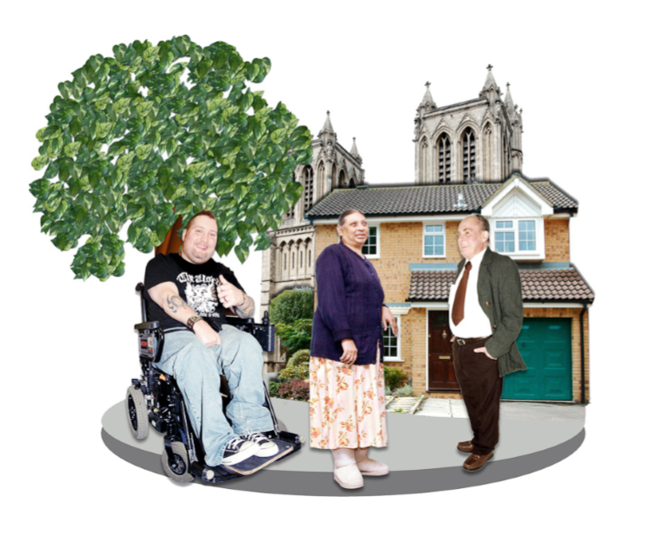
Conclusion
Safeguarding is everyone’s business
You must act lawfully
There will be implications for your role
What further learning do you need?
What actions will you need to take?
Notes:
The Act sets out what must and should be done to safeguard children and adults.
Safeguarding is everyone’s business and people must act lawfully – so you need to know the law, guidance and regulations that apply to your role.
You need to consider what should change in your practice and in the way your organisation works.
You should identify any further learning you need and the actions you will take to change the way you work.

